Slide 1
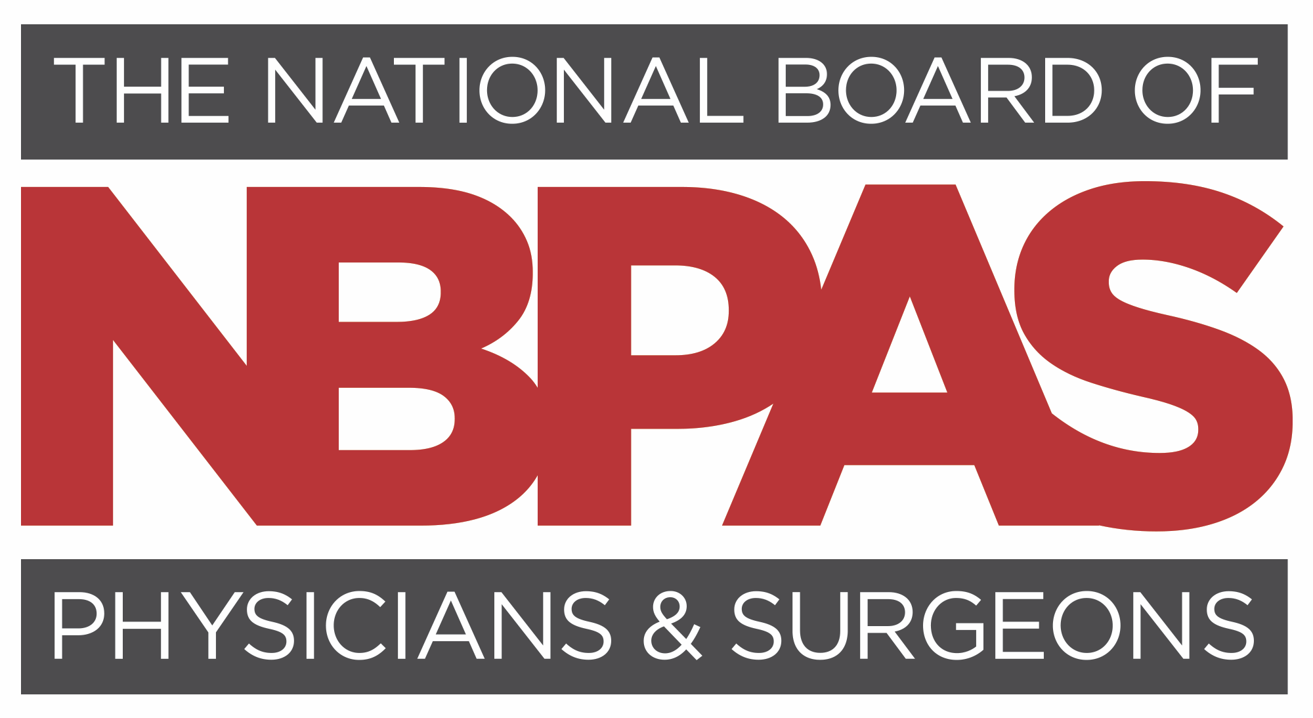

Slide 2
Brief Overview
Nonprofit Founded in 2015 by 20 physicians, thought leaders in clinical and academic medicine
Goal Support continuous and rigorous lifelong learning, clinical excellence, professionalism, and patient care through evidence-based CME
Requirements
streamlined, less burdensome, specialty specific, designed to reduce physician burden and burnout
Certifies 11,000+ physicians
in all 50 states and at hospitals and health systems, telemedicine; adding 100-300 new physicians/month
Provides competition and choice in continuing certification

Slide 3
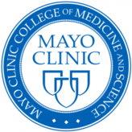
Leadership: Unpaid Physician Board of Directors

Slide 4
Common Questions and Answers
for Hospitals, Health Systems, Medical Executive Committees and Medical Staff Offices

Slide 5
Is NBPAS “Accepted”?
NBPAS meets national accreditation standards for:
Hospitals: The Joint Commission, DNV, CIHQ, ACHC
Health Plans: NCQA and URAC
Primary Source Verification (PSV) performed for all physicians
Accepted at nearly 200 hospitals, health systems, telemedicine companies, private practices, payers, and growing steadily

Slide 6
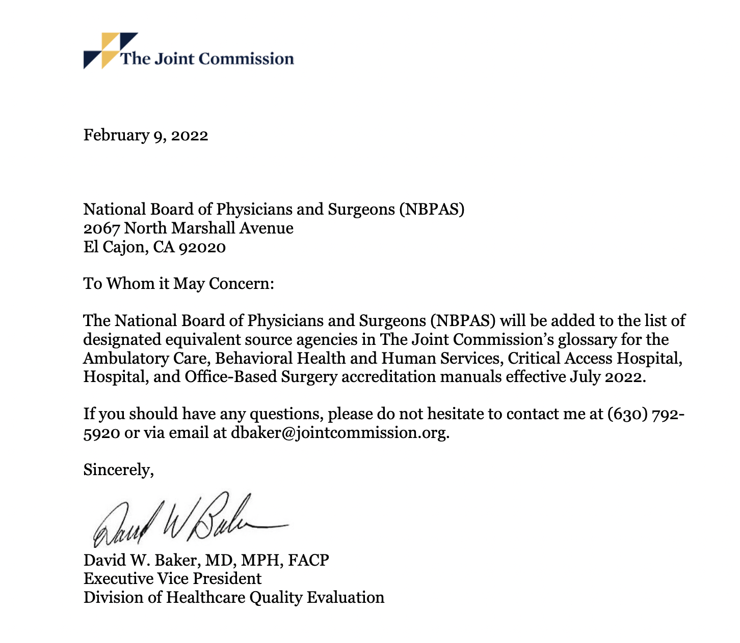
NBPAS added as an “designated equivalent source agency” by TJC and an “acceptable source for board certification” by NCQA.

Slide 7
What About Health Insurance Companies?
Widespread and Growing Recognition
Meets national accreditation standards by CMS-deemed agencies for health plans (NCQA, URAC)
Important: These standards allow hospitals to determine internal physician credentialing requirements, not health plans.

Slide 8
What are NBPAS Clinical and Professional Requirements?
ACGME-accredited residency and/or fellowship
Initial board certification through an ABMS/AOA member board in the applied-for specialty
Minimum 50 AMA PRA Category 1 CME™ (100 CME if previous certification lapsed)
Active/unrestricted medical license
Outpatient/hospital privileges (certain surgical specialties)
2-year recertification cycle
$94.50/year regardless of number of specialties, 72% savings (on average)

Slide 9
Will NBPAS Help Reduce Costs?
ABIM
NBPAS
Annual MOC/LKA fee: $220
1 sub-specialty: $120
Annual NBPAS cost: $94.50
10-year total = $3,400*
10-year total = $945
*Does not include $700 exam fee (if needed) or travel, lodging, time away from patients, and other indirect expenses.
72% AVERAGE SAVINGS with NBPAS

Slide 10
How Does NBPAS Compare To Other Continuing Certification Options?
NBPAS
ABMS/AOA
No “Grandfathering;” same requirements for all physicians
ACCME-accredited AMA PRA Cat 1 CME™ required
Specialty-specific learning requirement consistent for all physicians
CME checked by NBPAS team
“Grandfathering” exempts up to 40% practicing physicians from requirements
ACCME-accredited AMA PRA Cat 1-CME™ now allowed to substitute for MOC credits
Additional MOC modules required, multiple versions over time, vary by board

Slide 11
“Grandfathering:” Unintended but discriminatory impacts
Grandfathered physicians
are:
Up to 40% U.S. Physicians historically in this category
Discriminatory based on age, race and gender
NBPAS: Strongly supports Diversity, Equity, and Inclusion
80% CAUCASIAN
70% MALE
Same requirements for ALL Physicians
No exceptions based on age or length of practice
AAMC, Diversity in the Physician Workforce, 2010

Slide 12
What Does Data Say About MOC?
PubMed Literature Review
26 focused on outcome metrics
139
STUDIES
comparing time limited and time-unlimited board certification
Reduction in complications
Reduction in medical errors
Improved patient safety
Improved quality of care
Improved patient outcomes

Slide 13
MOC requirement and ambulatory care-sensitive hospitalizations (JAMA 2014 Dec 10;312(22):2348-57 Gray et al.)
Preventable hospitalizations through better quality and access to care
Significant impacts to hospital costs
Compared outcomes of 154,045 patients
No differences associated with participation in MOC
956 physicians time-limited (MOC required), 974 time-unlimited (MOC not required)

Slide 14
Association Between Physician Time-Unlimited vs Time-Limited Internal Medicine Board Certification and Patient Care Quality
(JAMA. 2014;312(22):2358-2363. Hayes, et al)
Four VA hospitals, 68,213 patients
Ten primary care performance measures
colorectal screening rates
diabetes with glycated hemoglobin (HbA1c level) less than 9.0%
diabetes with blood pressure less than 140/90 mm Hg
diabetes with LDL cholesterol level less than 100 mg/dL
hypertension with blood pressure less than 140/90 mm Hg
No differences in outcomes for patients cared for by internists with time-limited (MOC) or time-unlimited (no MOC) certification for any performance measure
thiazide diuretics used in multidrug hypertensive regimen
atherosclerotic coronary artery disease and LDL-C level less than 100 mg/dL
post-myocardial infarction use of aspirin
post-myocardial infarction use of β-blockers
congestive heart failure (CHF) with use of angiotensin-converting enzyme (ACE) inhibitor

Slide 15
Association Between Board Certification, Maintenance of Certification, and Surgical Complications in the United States (Am Journal Med Quality Nov/Dec 2019; 34 (6): 545-552)
Patient outcomes study
Medicare claims for 1.9 million elective surgical procedures
14,598 physicians (64% orthopedics, 17% general surgery, 11% urology, 7% neurosurgery)
Completion of MOC was NOT associated with differences in complication rates

Slide 16
U.S. Department of Justice weighs in (2018)
"More competition by bona fide certifying bodies may offer important benefits — including lowering the costs for physicians to be certified or improving the quality of certification services — for healthcare providers, consumers, and payers,"
Physicians should have "flexibility to present themselves as board certified." They are urged to "redefine board certification" so that "physicians still qualify as board certified if they lose certification only because they did not participate in MOCs."

Slide 17
What Makes NBPAS Especially Important? State of Medicine:
Burnout/physician shortage
serious and growing, up to 25% Leaving Practice within 5 years, nationwide
(Missouri Medicine, 2018)
“Physician Side Gigs,” Facebook group of 155,000+ looking to build a career outside of medicine
Physician shortage growing to 124,000+ by 2034
(AAMC, June 2021)

Slide 18
NBPAS benefits physicians
Provides rigorous, specialty-specific lifelong learning
Streamlined criteria and process to reduce burnout and administrative burden
Time saved = Increased focus on patient care
Economical
Equity: Same requirements for all physicians
Notes:
Benefits for physicians

Slide 19
NBPAS benefits hospitals and employers
Supports recruitment/retention of board-certified physicians
Reduces direct, hospital-borne costs of recertification by up to 72%
Reduces indirect costs: lost time, productivity, and physician turnover
Estimated $260 million is lost to physician burnout and turnover⁴—paid for by employers, health plans, and taxpayers.
Supports diversity, equity, and inclusion goals (time-unlimited ”grandfathering” strictly prohibited)
Fosters a physician-friendly culture
⁴Sharon Donovan. Primary Care Burnout: The $260 Million Problem. medscape.com. https://www.medscape.com/viewarticle/969475?uac=437633FZ&faf=1&sso=true&impID=4061007&src=WNL_dne5_220303_MSCPEDIT. March 02, 2022.

Slide 20
How do I add NBPAS to Hospital Bylaws?
Straightforward
Medical Executive Committee reviews and accepts
NBPAS added to hospital bylaws credentialing guidelines

Slide 21
NBPAS in Bylaws: Two Examples
Each Physician Practitioner shall be currently certified by the specialty board appropriate to the clinical privileges being requested, either by the American Board of Medical Specialties (ABMS), American Osteopathic Association (AOA), or National Board of Physicians and Surgeons (NBPAS) and must maintain that board certification during membership on the Medical Staff.
Each physician shall be initially certified by the specialty board appropriate to the clinical privileges being requested, either by the American Board of Medical Specialties (ABMS), American Osteopathic Association (AOA), and shall maintain continuous certification during membership on the medical staff through the ABMS, AOA, or National Board of Physicians and Surgeons (NBPAS).

Slide 22
Is NBPAS “Equivalent” to ABMS/AOA?
NBPAS does not provide initial board certification but requires it without exception.
NBPAS is a pathway for continuous certification, after completing Initial Board Certification from an ABMS or AOA member board.
NBPAS Certification was created for physicians by physicians, providing a continuous board certification pathway that is evidence based, specialty specific, and clinically relevant.
NBPAS Certification meets national accreditation requirements for both insurers and hospitals. (NCQA, URAC, TJC, DNV, CHIQ and ACHC)
NBPAS Strives to elevate the practice of medicine over the business of medicine by eliminating obstacles, distractions and interference allowing more time for physicians to equitably care for patients.

